Slide 1
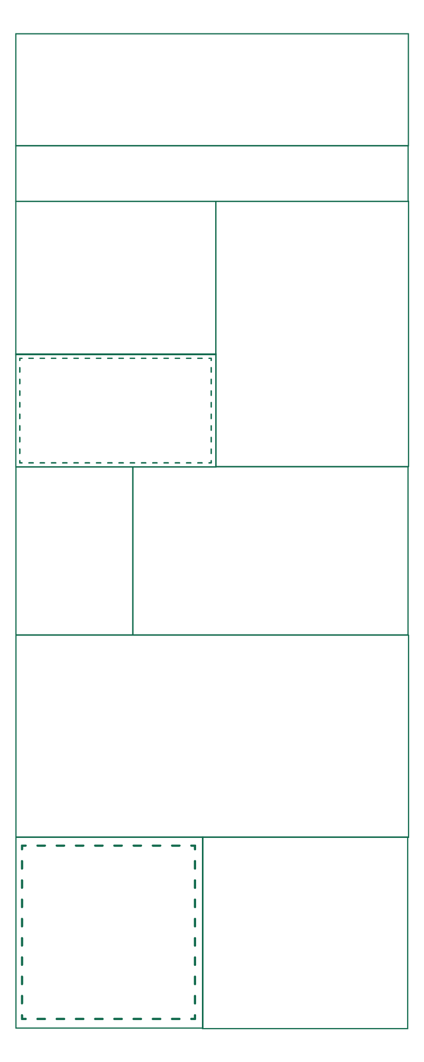




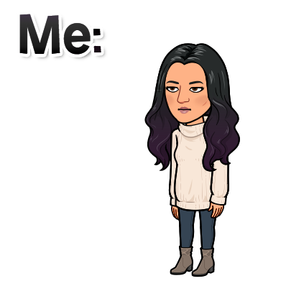



Having a hard time reading something?
Remember, you can zoom in on any part of this document. Just use the zoom button. The little dropdown arrow next to it has an option called “zoom in.”
Lauren E. Levesque
Option 1
(Example with Instructions)
Write your name.
End-of-Term Reflective Infographic
One assignment I enjoyed was the book report with choices. It was fun to do something creative.
Write the title of the best thing you read this term.
by
Agnieszka Biskup
Batsuits and Capes
This term, what assignment did you enjoy the most (or interested you the most)?
One thing I would like to learn more about is the different types of writing you might have to do for your job.
What is something you would like to learn about (or learn more about)?
Paolo Coelho
Ask yourself if what you’re doing today is getting you closer to where you want to be tomorrow.
Write a quote that inspires you.
Insert a picture related to the app (or website) you liked best.
My grade accurately reflects my work and work ethic because my grade was a C, and that’s about how much effort I put forth.
One strength I could use to improve my grade is to relax so I stop procrastinating and just do my best and not have to worry.
How well does your grade reflect your work and work ethic? Which of you strengths could you use to improve your grade or to keep the grade you have?
Or you can click the zoom button and then click and drag the area you want to zoom in. That way, it’s zoomed to exactly the part you need! And you can always zoom out by choosing “fit” in the zoom dropdown menu.
One thing I am proud of is coming to class on time and revising my writing instead of just accepting their grade when I get them back. Since I get the opportunity to make them up I should.
I did most of the assignments, but next term, I will work harder to attempt the assignments even if it doesn’t look perfect or is not completely finished.
What is one thing you are proud of doing this term?
What is one thing you could work on doing better next term?

Slide 2
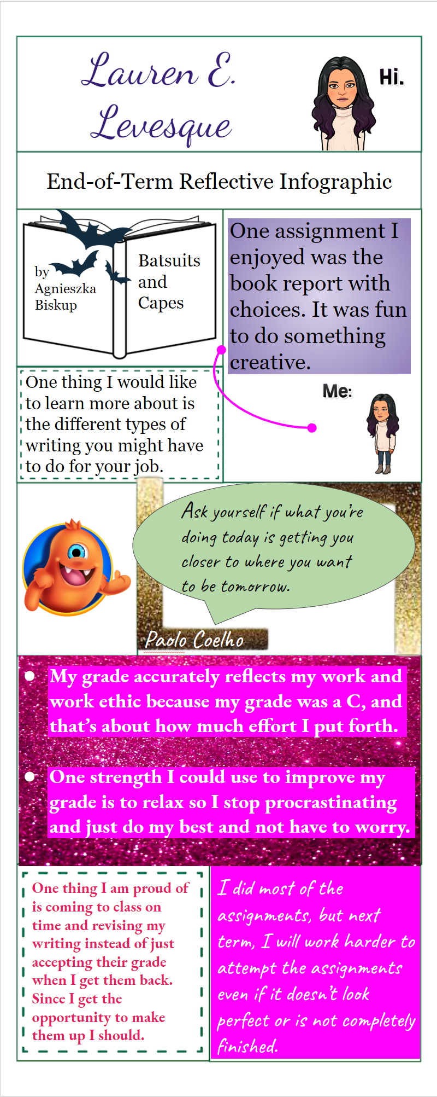
Having a hard time reading something?
Remember, you can zoom in on any part of this document. Just use the zoom button. The little dropdown arrow next to it has an option called “zoom in.”
Option 1 (Example)
Or you can click the zoom button and then click and drag the area you want to zoom in. That way, it’s zoomed to exactly the part you need! And you can always zoom out by choosing “fit” in the zoom dropdown menu.

